Slide 1
File Management
Josh CJ Web Dev

Slide 2
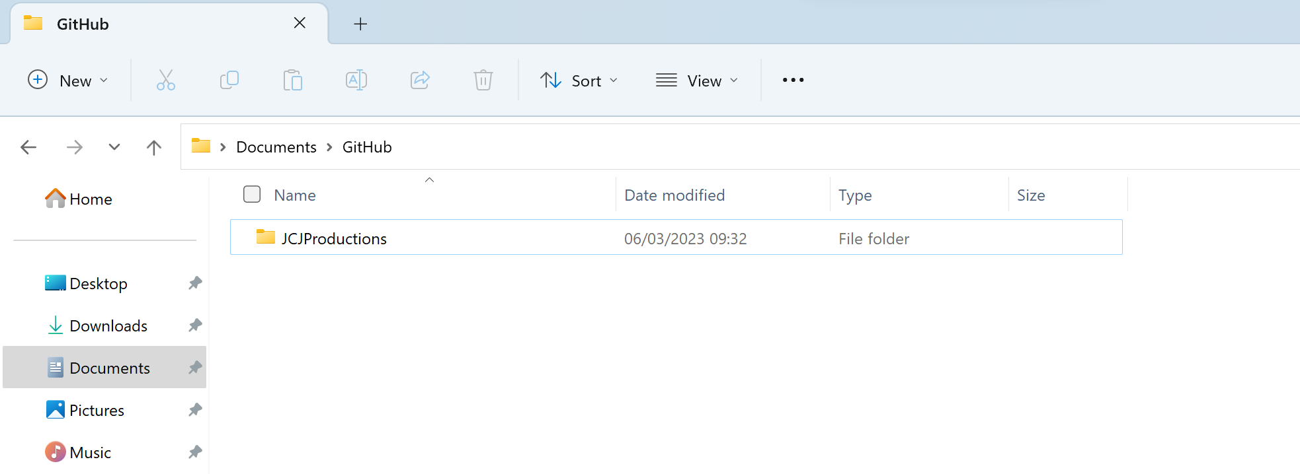
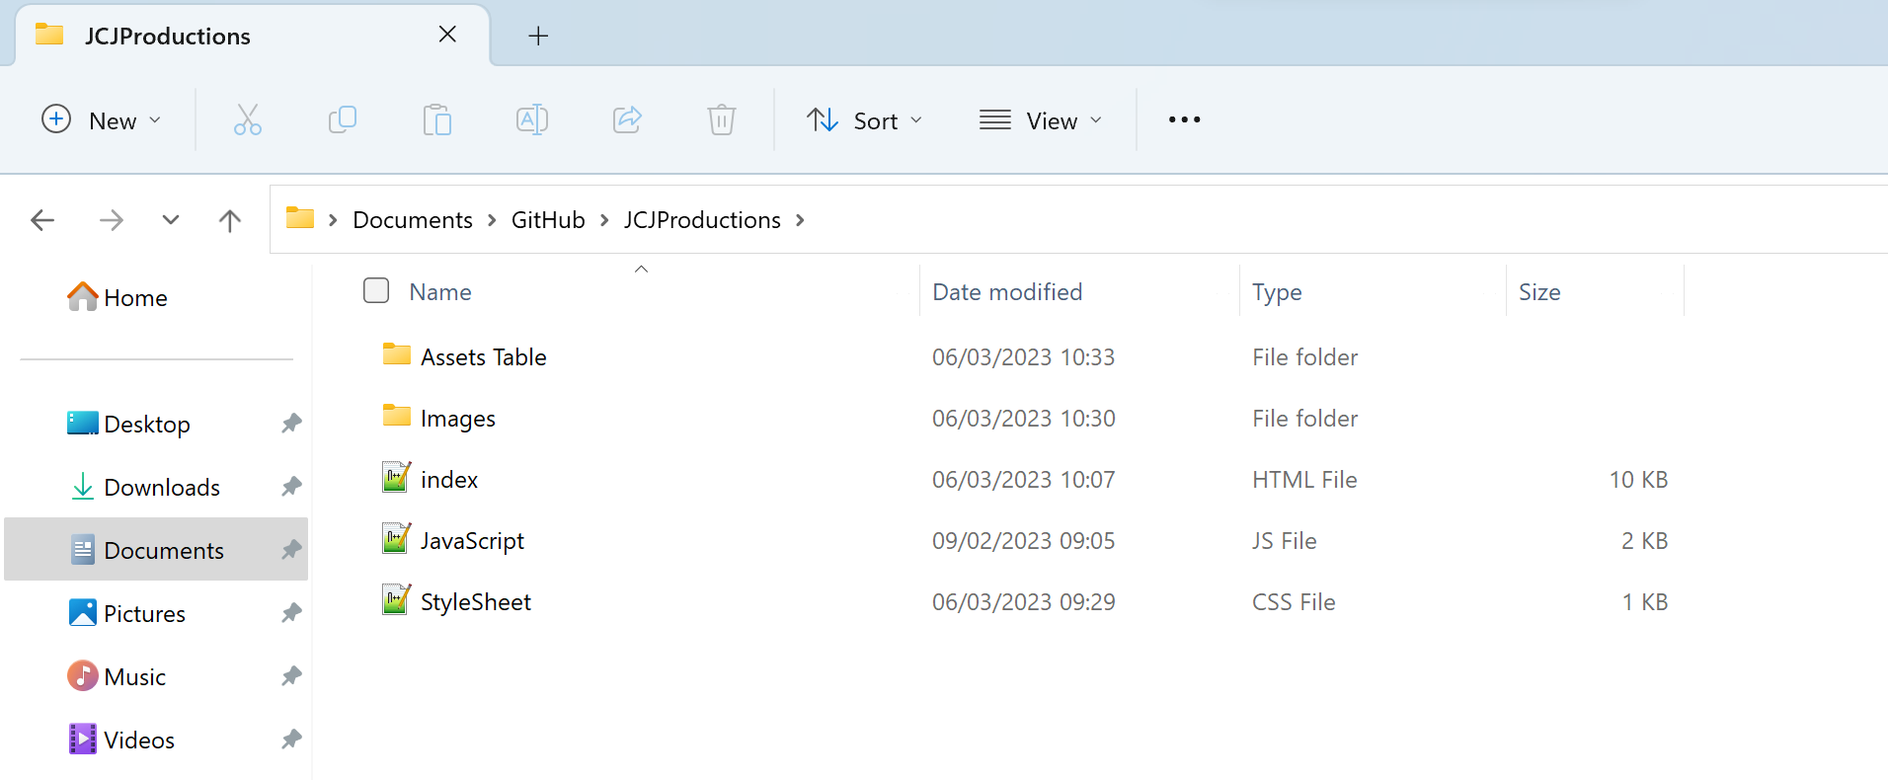
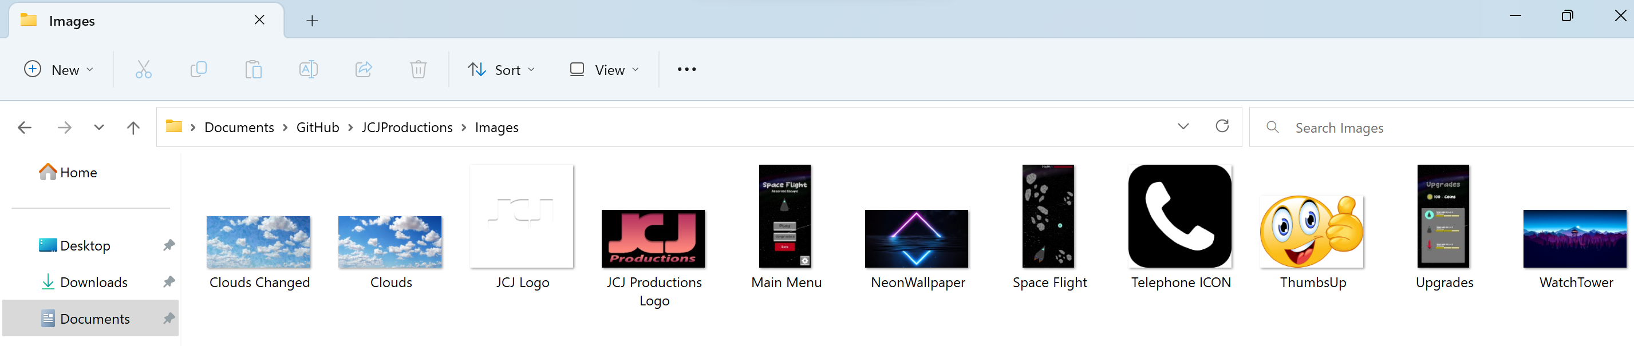
Images
JCJProductions > Images (Images Folder)

Slide 3
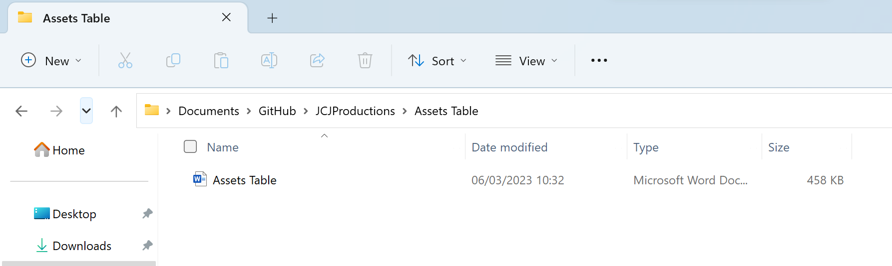
Assets Table
JCJProductions > Assets Table (Assets Table)

